Slide 1

Realtime twitter sentiment analysis and food labeling
Neel Shah
http://www.free-powerpoint-templates-design.com

Slide 2
Index
01
About
Why we are doing this?
02
About data
About training dataset
03
Sentencelabel library
New developed library
04
Future plan
Future road map

Slide 3
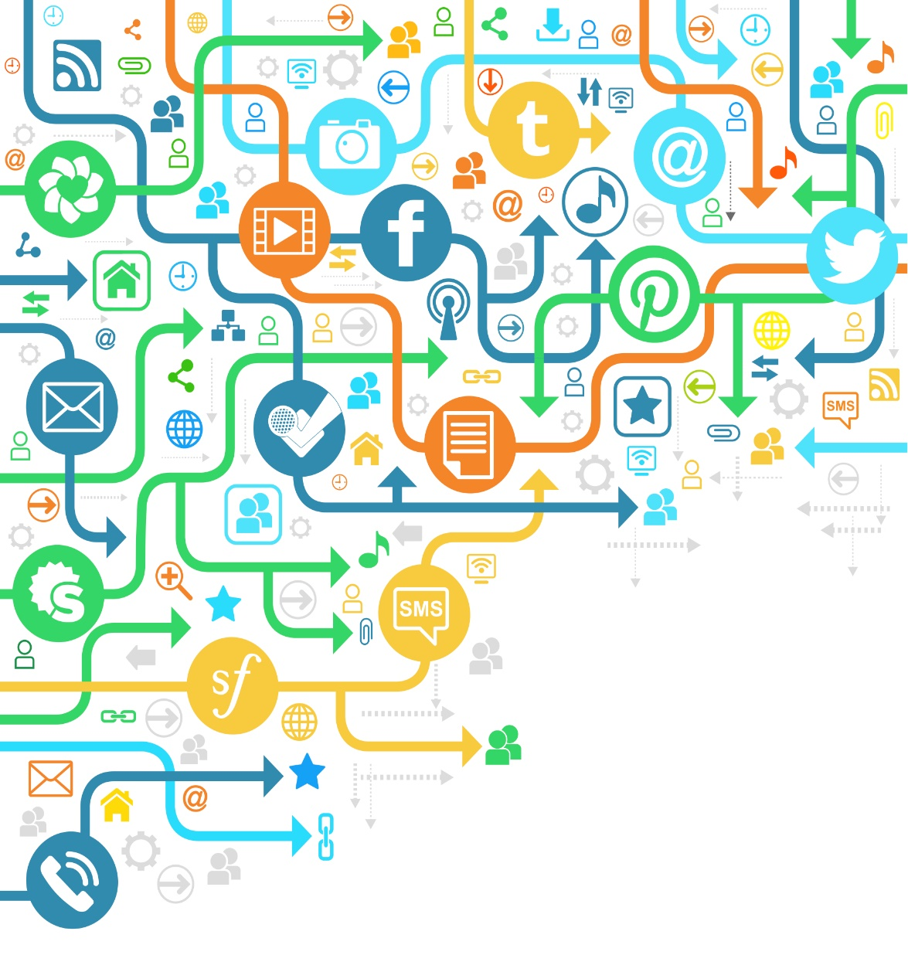
About
Understanding of Twitter data.
Finding food habits of people.
Realtime analysis
Work on large geographical area.

Slide 4
System
Sentiment
Labeling
Realtime
Understanding
Finding people’s view on subject
Classification of type of data
Visualization of data
Understanding the larger picture

Slide 5
We trying to answer
What is sentiment?
Knowing about the tweet is positive or negative
What people eat?
What people do?
What people like pizza, burger, ice-cream, etc.
What people do regularly walking, watching tv, etc.
Average calorie
What is their average calories

Slide 6
About the data
Trained model
Train the model for sentiment analysis and save it for reuse
MODEL
70,000
Training data
Twitter stream
Labeled tweet to train model which contains sentiment, food flag and tweet text.
Collection of twitter data from 1year through streaming api(ongoing)
~750 MILLIONS

Slide 7
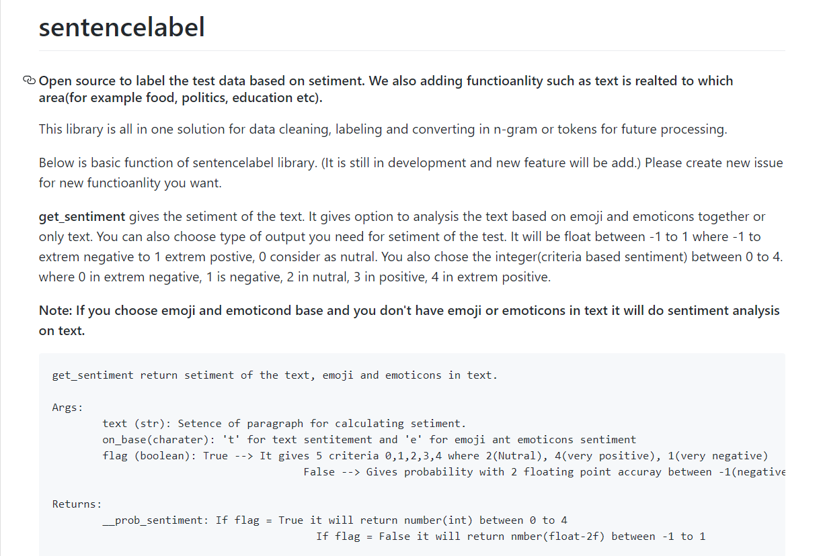

Developed: Sentencelabel library
It working on backend of nlntk_{[1]} and textblob_{[2]} libraries.
It provides auto cleaning of data with flexibilities of cleaning choices.
It also check the label data is it related to food or not.
Gives the sentiment of the tweet based on NB algorithm(~83% efficient)_{[2]}.
Gives sentiment based on emoji option.
Option to convert the data in n-gram, tokenizes etc.
It also includes spelling checker and stop words remover.
Avilable under: MIT Licence
setencelabel@
Fig. 1 Sentencelabel libarary

Slide 8
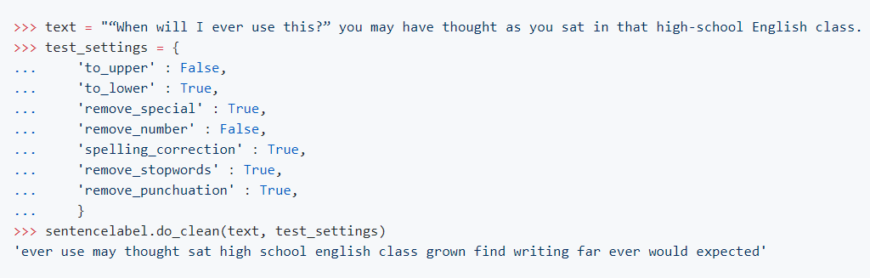
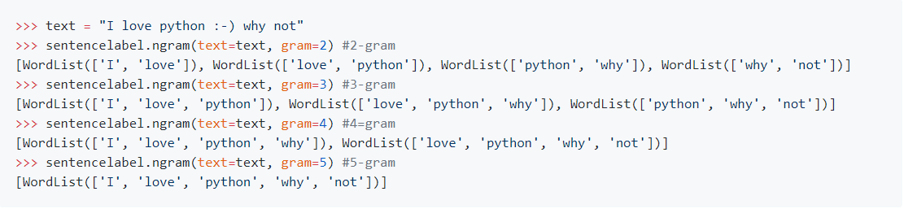
Fig. 2 do_clean() function of sentencelabel library
Fig. 3 ngram() function of sentencelabel library

Slide 9
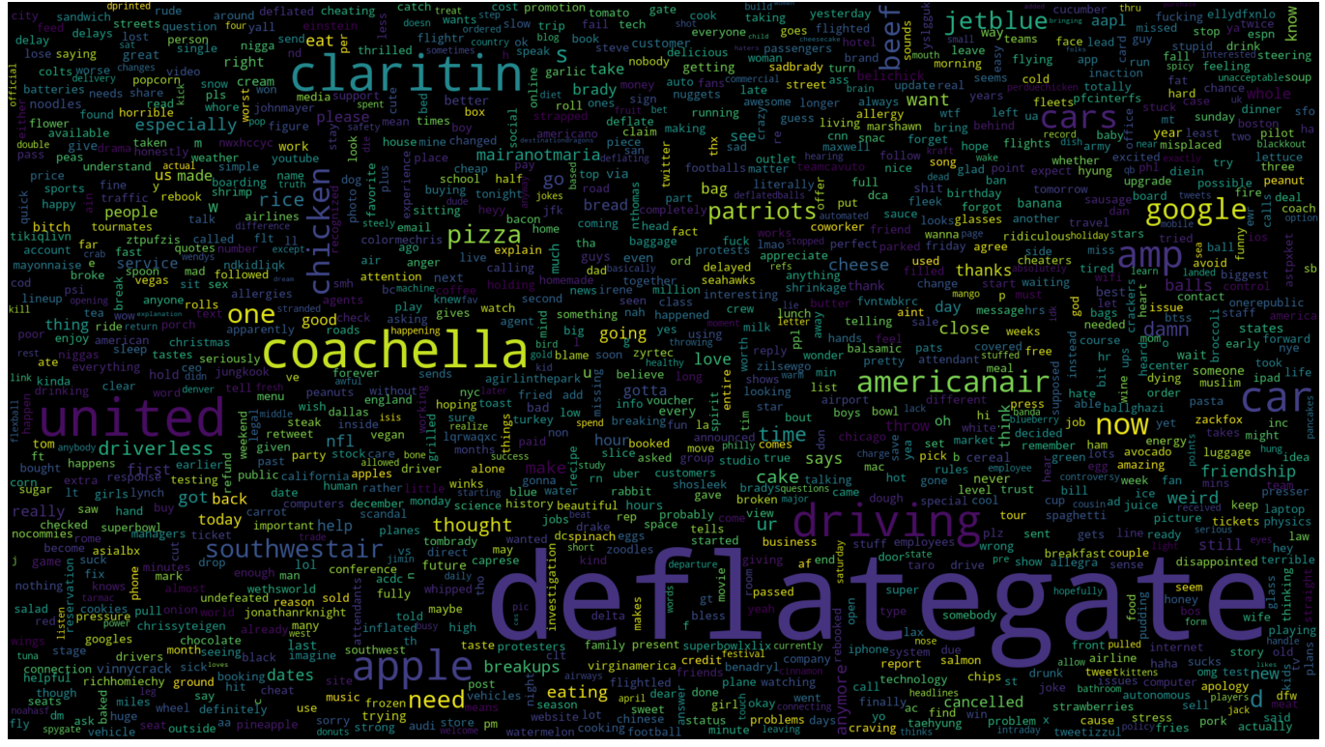
Word cloud
Fig. 4 Word cloud of 70,000 label tweet dataset.

Slide 10
Future path
Training and testing of different models.

Slide 11
Reference
1) https://github.com/sloria/TextBlob
2) https://github.com/nltk/nltk
PPT template source:
http://www.free-powerpoint-templates-design.com/
Image source:
http://chittagongit.com/icon/sentiment-icon-12.html
https://www.golegal.co.za/brands-social-media/

Slide 12


Thank you
Contact me

